Slide 1
Online Chatbot Based Ticketing System (for Museums)
CSE7301 Capstone Project
Final Viva-Voce
Batch Number: CSE-G50
Roll Number | Student Name
20211CSE0631 | Prashanth S N
20211CSE0666 | Nithin H M
20211CSE0889 | Kanala Krishna Samhith
Under the Supervision of,
Mr. Syed Mohsin
School of Computer Science and Engineering
Presidency University
Name of the Program: CSE
Name of the HoD: Dr. Asif Mohammed H.B
Name of the Program Project Coordinator: Mr. Syed Mohsin
Name of the School Project Coordinators: Dr. Sampath A K / Dr. Abdul Khadar A / Mr. Md Ziaur Rahman

Slide 2
Introduction
Manual ticketing systems in museums often result in long queues, inefficiencies, and errors that negatively impact the visitor experience. During peak hours, weekends, and special events, these issues become more prominent, leading to customer dissatisfaction and operational delays. Inaccurate ticket issuance, double bookings, and lost records further strain the system, damaging both reputation and revenue.
To overcome these challenges, this project proposes an AI-powered chatbot-based ticketing system that automates the entire booking process—from gate entries to event passes. The chatbot offers a seamless, conversational interface for users to book, cancel, and manage tickets, while also integrating with secure payment gateways for end-to-end automation.

Slide 3
Literature Survey
Highlights the use of chatbots in customer service and ticketing systems in travel and tourism.
Manual ticket counters and basic online portals lacked automation, leading to long queues and human errors.
Examines existing ticket booking systems in museums, focusing on manual and online systems.
Focuses on how chatbots can enhance user experience and accessibility in cultural institutions.
Focuses on the role of chatbots in enhancing user experience in web-based systems.
Enhances automation, reduces workload, and handles large user volumes efficiently.
Modern systems integrate gateways like Razorpay for safe, seamless transactions.

Slide 4
Literature Survey
Key Technologies Explored:
MERN Stack: MongoDB, Express.js, React, Node.js used for full-stack development. (Link)
Relevant Works:
Chatbot-based ticketing in airlines: Reference: https://ieeexplore.ieee.org/document/9058283
Tourism chatbot case studies: Reference: https://sciendo.com/article/10.2478/acss-2023-0023

Slide 5
Literature Survey
Key Findings:
Most chatbot integrations are found in e-commerce, airlines, or cinema booking. Museums and government-backed tourism still rely heavily on manual or semi-digital ticketing systems.
Museum/tourism ticketing bots are rare compared to airlines and movies only for user guidance not for booking a ticket.
Tourists often need to visit multiple websites or counters to book entry tickets, shows, and guided tours — no unified experience.

Slide 6
Objectives
Seamless Conversational Booking - Replace traditional form-driven workflows with an AI-powered chatbot that guides users step-by-step through museum ticket booking.
Integrate Razorpay for real-time payment processing and automated refund handling directly through the chatbot.
Enable users to view, download, and cancel their tickets on demand; enforce stale-date checks to prevent booking for past dates. (Real-Time User & Ticket Management)

Slide 7
Objectives
Leverage the MERN stack (MongoDB, Express, React, Node.js) for a performant, maintainable codebase, easily deployable to cloud platforms.
Use Google’s Gemini API for “Ask Something Else” freeform Q&A, ensuring users always have contextual help beyond standard ticketing flows.
Implement inactivity timeouts, session persistence, and “Restart” commands to keep conversations fresh and avoid stale states.
Design a mobile-first, responsive UI with dark-mode support and clear visual cues, ensuring everyone can book tickets effortlessly.

Slide 8
Existing Methods
Manual Ticket Counter
Long queues and human errors.
Mobile Apps
Require app downloads, device compatibility issues.
Email or Phone-based Ticketing
Manual data entry, prone to errors.

Slide 9
Live Existing Chatbot Ticketing System
Ask Disha 2.0 (IRCTC Ticket Booking Bot)
Red Bus Chatbot (platform: whatsapp)
Bookmyshow Chatbot (platform: whatsapp)
KLM Royal Dutch Airways (Bluebot)
Lufthansa Bot (Lufthansa Chat Assistant)

Slide 10
Live Existing Chatbot Ticketing System For Museums
Louvre Museum, Paris ( platform: Louvre Museum )
Jewish Historical Museum, Amsterdam ( cultural chatbot: a virtual museum tour guide )
Museu do Amanhã, Rio de Janeiro ( chatbot: IRIS+)
National Art Museum of the Republic of Belarus, Minsk ( platform: Facebook messenger bot )

Slide 11
Drawbacks For Existing Methods
Inefficiency & Long Wait Times
Human Errors in Ticketing
Lack of Real-time Data
Limited Customer Support
Scalability Issues
Accessibility Problems
High Operational Costs

Slide 12
Drawbacks In Chatbot Ticketing System
Limited understanding of complex queries - contextual or ambiguous questions leads to incorrect response
Technical glitches and errors - system failure or bugs in NLP leads to incorrect response
Security and privacy concerns - for handling private transactions
Dependency over internet and technology - requires stable internet

Slide 13
Proposed Method
Step-by-Step Booking Flow
Improved Customer Service
Efficient Handling of High Volumes
Cost-Effective Solution
Data Collection and Analysis
Accessibility and Reduced Human Error
Secure Payment Gateway(Rasorpay)
Enhanced Marketing and Promotion

Slide 14
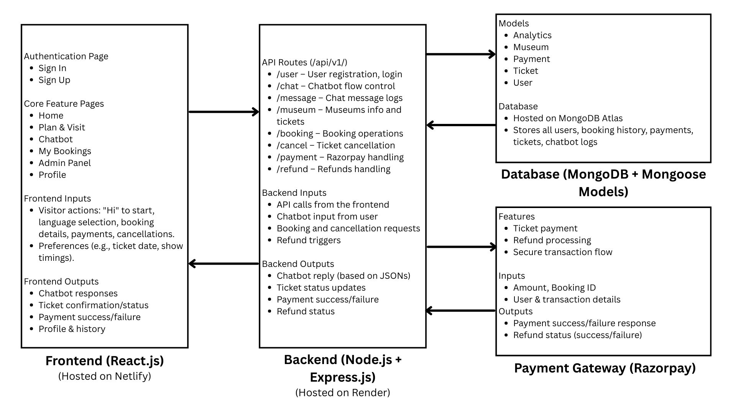
Architecture Diagram

Slide 15
Modules
User Module
Manages user accounts, roles, and authentication.
Purpose: User registration, login, admin/user access, and password recovery.
Ticket Module
Handles museum ticket booking, status, and visitors.
Purpose: Book, cancel, and track tickets for museum visits.
Payment Module
Processes and tracks online payments securely.
Purpose: Manage payments, refunds, and transaction history.
Museum Module
Stores museum data and ticket availability per date.
Purpose: Track and manage ticket inventory dynamically.
Analytics Module
Tracks overall system usage and performance.
Purpose: Gain insights into bookings, revenue, and chatbot engagement.

Slide 16
Hardware and Software Details
Software Requirements:
Operating System
Windows, macOS, or Linux: Any modern OS capable of running development environments.
Development Environment
Code Editor: Visual Studio Code.
Node.js: For back-end development and running JavaScript on the server side.
Database Management Tool: MongoDB.
Version Control
Git: For managing version control and collaboration.
GitHub: For hosting the repository.

Slide 17
Hardware and Software Details
Hardware Requirements:
Development Machine
Processor: Intel i5 (or equivalent AMD) or higher.
RAM: 8GB or more for handling multiple tasks such as running the local server, browser, and development tools simultaneously.
Storage: 256GB SSD or more for faster performance and to handle development tasks quickly.
Internet Connection
Stable broadband connection for accessing APIs, cloud storage, and deploying the application to cloud platforms.

Slide 18
Timeline of the Project (Gantt Chart)
Task | Review 0 | Review 1 | Review 2 | Review 3 | Final Viva-Voce
Project Proposal & Abstract Submission | ✓
Tech Stack Finalization & Architecture | ✓ | ✓
UI/UX Design & Wireframes |  | ✓
Database Schema Design (User, Ticket…) |  | ✓
Backend Development (Auth, Models, APIs) |  | ✓ | ✓
Chatbot Development with step by step flow |  |  | ✓ | ✓
Payment Gateway Integration |  |  | ✓
Testing, Bug Fixing & Optimization |  |  |  | ✓
Deployment & Hosting |  |  |  | ✓ | ✓
Final Report, PPT & Viva Preparation |  |  |  |  | ✓

Slide 19
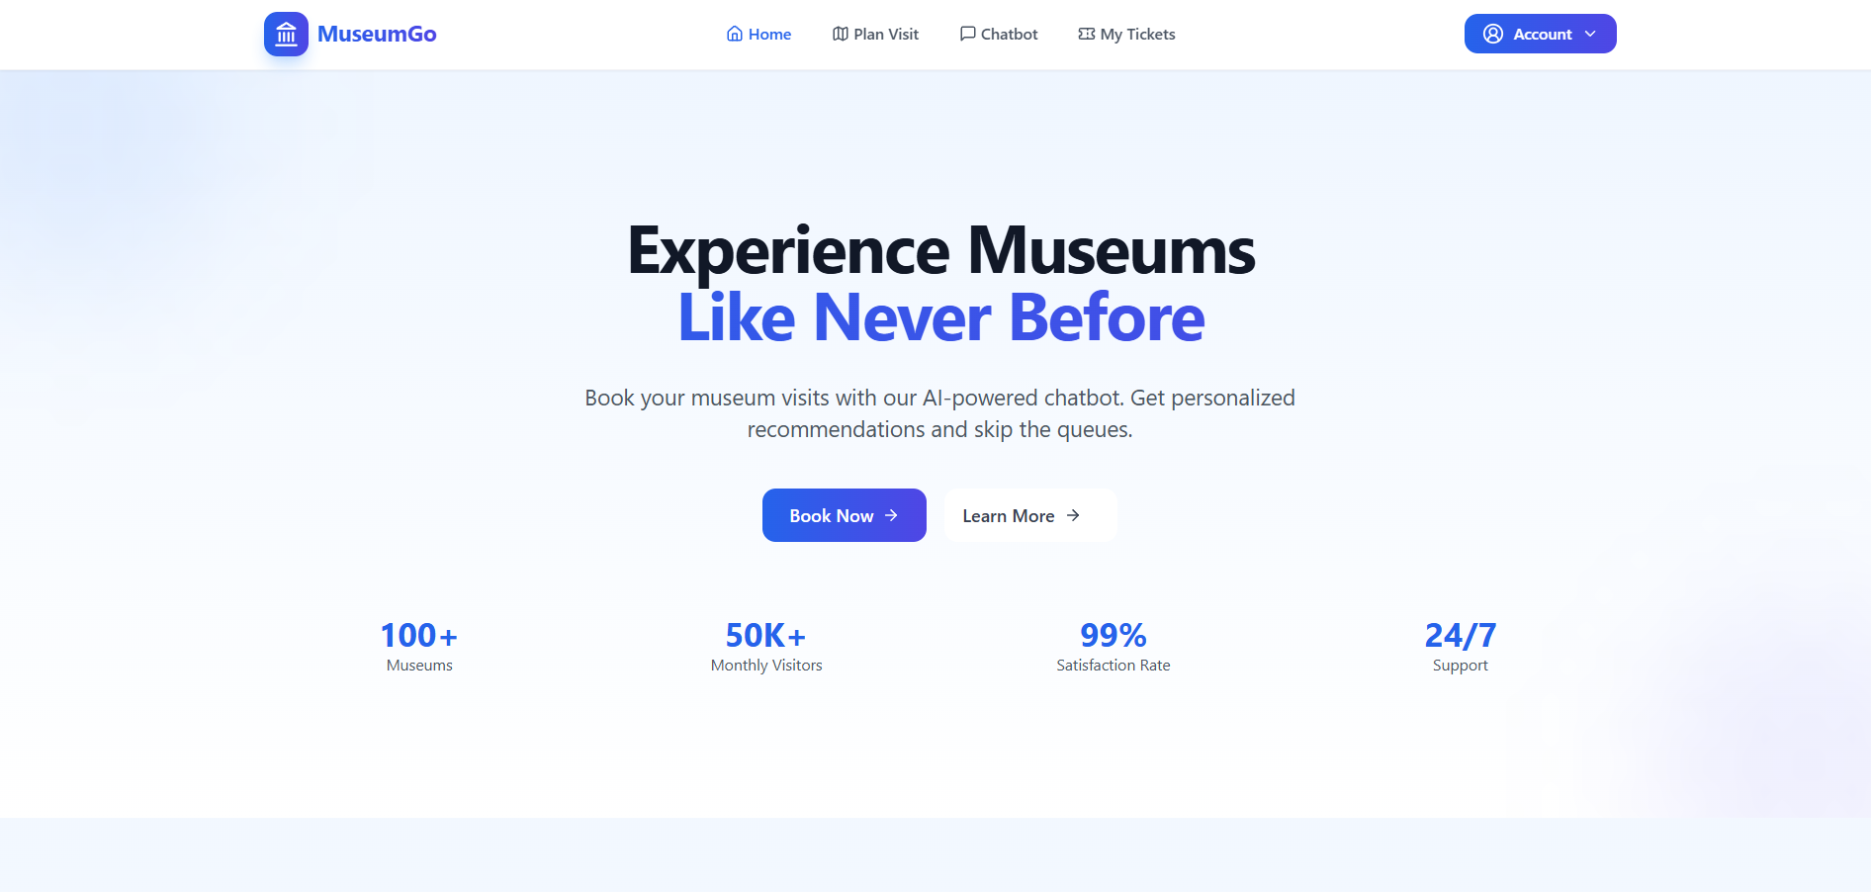
Output :

Slide 20
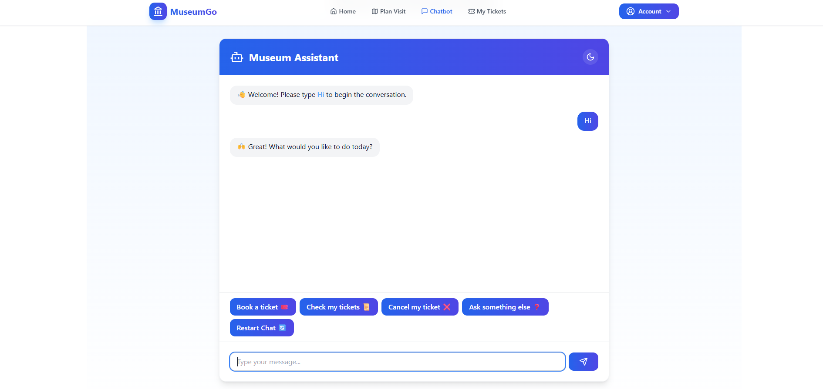
Output :

Slide 21
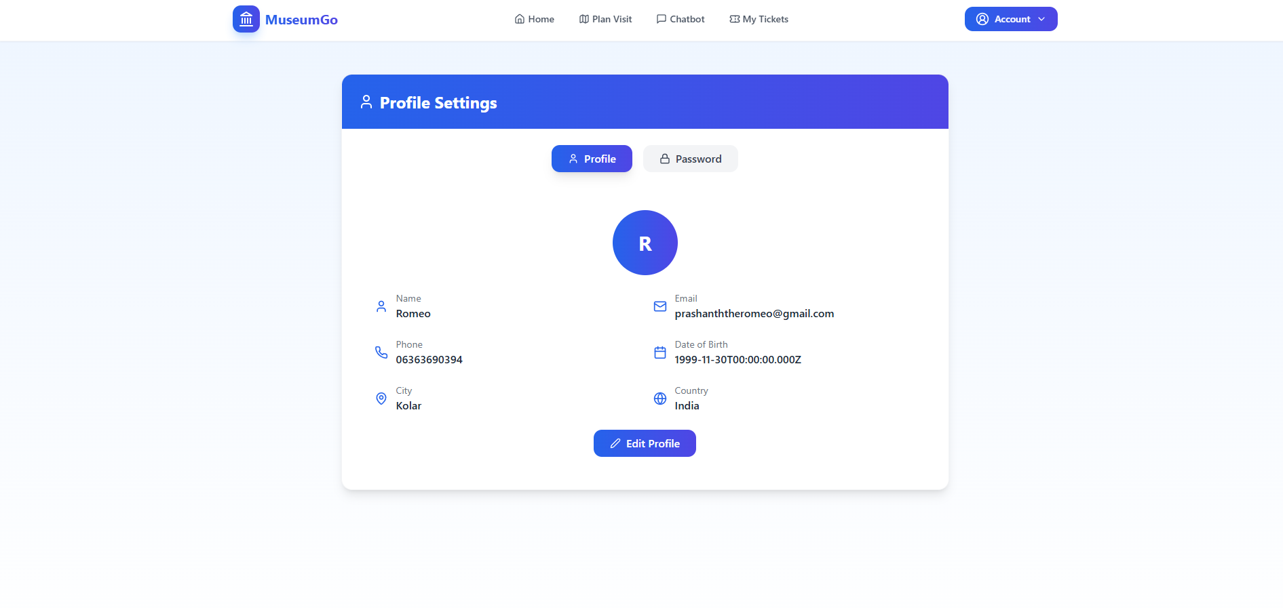
Output :

Slide 22
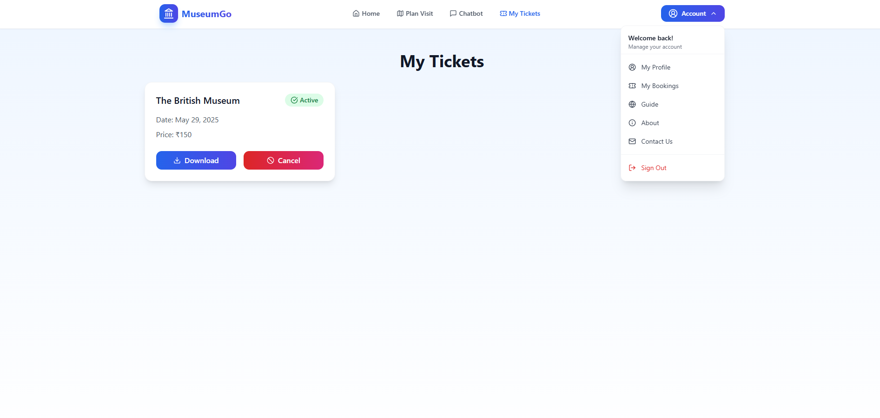
Output :

Slide 23
Paper Publication Details
Paper Title: Online Chatbot Based Ticketing System
Author(s): Prashanth S N , Nithin H M , Kanala Krishna Samhith
Journal Name: International Journal of Innovative Research in Technology (IJIRT)
Paper ID: 178391
Volume / Issue: Volume 11 Issue 12
DOI / Link: https://ijirt.org/Article?manuscript=178391
ISSN (Online): 2349-6002

Slide 24
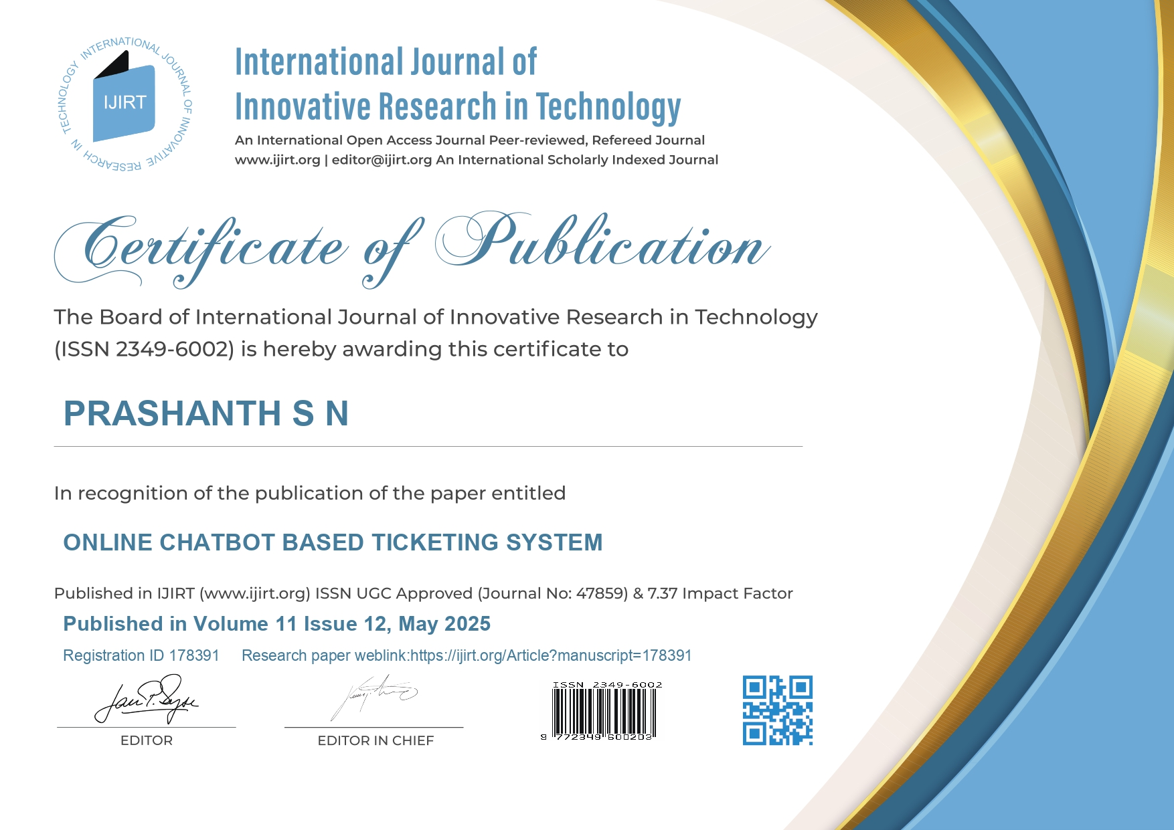
Publication Certificates

Slide 25
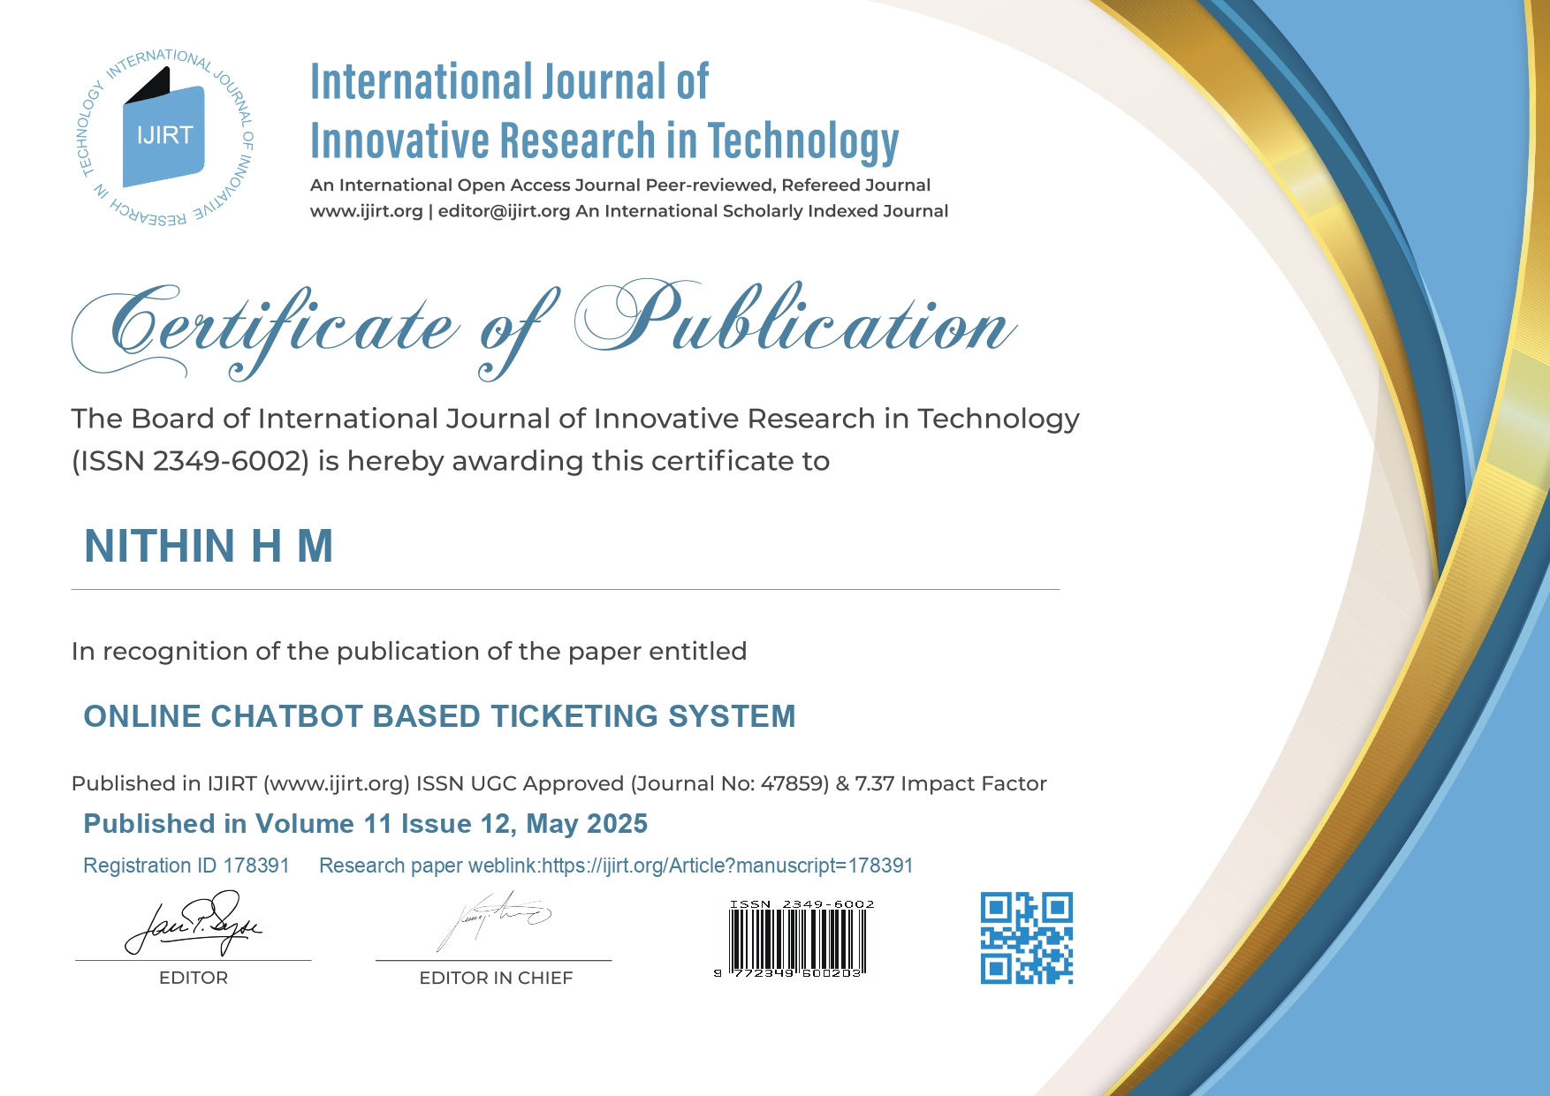
Publication Certificates

Slide 26
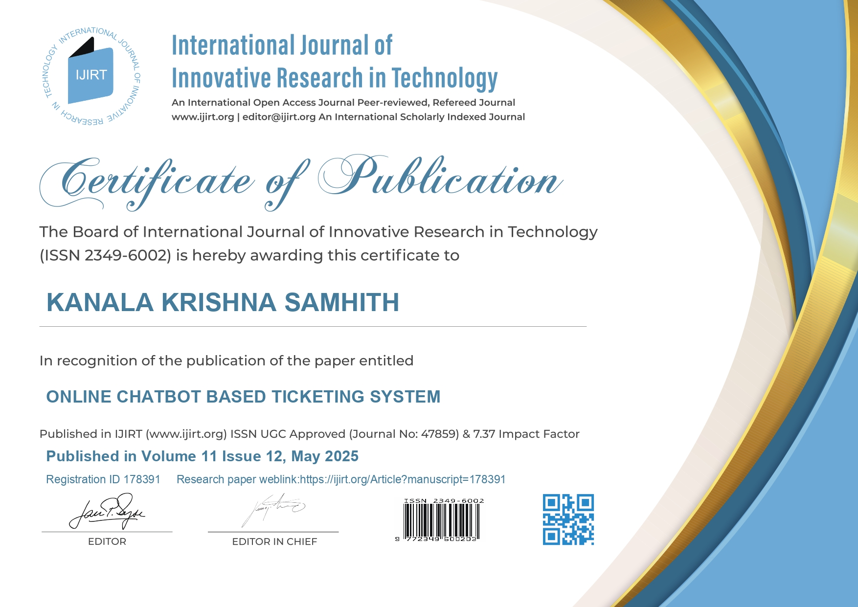
Publication Certificates

Slide 27
Importance of Technology
MERN Stack (MongoDB, Express.js, React.js, Node.js)Enables full-stack JavaScript development for seamless integration between frontend and backend.React.js provides a dynamic, responsive user interface for better user experience.Node.js + Express.js ensures scalable, efficient backend API handling. MongoDB offers flexible, schema-less data storage for booking and user records.
AI-Powered Chatbot Replaces traditional UI forms with a conversational interface. Enhances user engagement and simplifies complex processes like ticket booking and cancellation. Built to handle multilingual interaction, improving accessibility for regional users.
Razorpay Payment Integration Ensures secure online transactions for booking tickets. Real-time payment confirmation and refund handling via the chatbot.
Cloud Deployment Deployed using Netlify (Frontend) and Render (Backend) for 24/7 availability. Utilizes MongoDB Atlas, ensuring high-performance and globally accessible data storage.
Real-Time Analytics & Admin Dashboard Admins can monitor daily ticket stats, user activity, and make data-driven decisions.

Slide 28
Conclusion
The Online Chatbot-Based Ticketing System successfully bridges the gap between traditional museum ticketing and modern digital interaction. By integrating AI-powered chatbots, secure payment gateways, and real-time analytics, the system offers a seamless, user-friendly, and scalable solution for ticket booking in the travel and tourism sector.
This project not only enhances user accessibility and operational efficiency but also lays the foundation for a smarter, more inclusive, and automated future in cultural and tourism experiences. With modular architecture and robust technologies like the MERN stack and Google Gemini AI, the system is built for sustainability, adaptability, and continued innovation.

Slide 29
GitHub Link & Website Link
GitHub Repository (Public Access)
Explore the source code on GitHub:
https://github.com/Prashanth0718/ONLINE-CHATBOT-TICKETING-SYSTEM
Live Website
Visit the project live at: museumgo.in

Slide 30
References(Referring Research Papers)
[1] Chatbots in Tourism Industry: A Survey (Link)
https://www.sciencedirect.com/science/article/pii/S1877050919310360
[2] A Study of Ticket Booking Systems in Museums (Link)
https://www.researchgate.net/publication/323908463_TiteleiInhaltsverzeichnis
[3] Natural Language Processing (NLP) for Customer Service Chatbots (Link)
https://www.researchgate.net/publication/341501101_Natural_Language_Processing_for_Customer_Service_Chatbots
[4] Exploring Chatbots in the Context of Museums and Cultural Heritage Sites (Link)
https://www.sciencedirect.com/science/article/pii/S187705091930960X
[5] Multilingual Support in Chatbots for Global Customer Engagement (Link)
https://www.sciencedirect.com/science/article/pii/S187705091930960X
[6] Machine Learning-Based Automated Ticketing System (Link)
https://www.researchgate.net/publication/329366058_Machine_Learning_Based_Automated_Ticketing_System
[7] Chatbot-Driven Customer Service Automation: A Review (Link)
https://www.researchgate.net/publication/334425199_Chatbot-driven_Customer_Service_Automation_A_Review
[8] A Comparative Analysis of Payment Gateways for E-Commerce (Link)
https://www.sciencedirect.com/science/article/pii/S1877050919310966
[9] Improving User Experience in Web Applications Using Chatbots (Link)
https://www.researchgate.net/publication/335562545_Improving_User_Experience_in_Web_Applications_Using_Chatbots

Slide 31
Project work mapping with SDG
1. SDG 9: Industry, Innovation, and Infrastructure
Goal: Build resilient infrastructure, promote inclusive and sustainable industrialization, and foster innovation.
Target 9.5 Enhance scientific research, upgrade the technological capabilities of industrial sectors in all countries, particularly developing countries, including, by 2030, encouraging innovation and substantially increasing the number of research and development workers per 1 million people and public and private research and development spending.
Project Alignment with Goal The chatbot-based online ticketing system represents a technological upgrade in the heritage and cultural tourism sector. By automating ticket booking, query resolution, and real-time interaction, the system introduces modern, scalable, and sustainable infrastructure into traditional museum operations. This innovative approach encourages the integration of advanced technologies like AI and Natural Language Processing (NLP) into cultural institutions, thus fostering digital transformation and industrial innovation in public service sectors.
2. SDG 11: Sustainable Cities and Communities
Goal: Make cities and human settlements inclusive, safe, resilient, and sustainable.
Target 11.4 Strengthen efforts to protect and safeguard the world’s cultural and natural heritage.
Project Alignment with Goal By digitizing the ticketing process for museums, the project supports increased access to cultural institutions while ensuring efficient crowd management, timely ticket issuance, and improved visitor planning. This technological integration helps museums operate more sustainably and attract a wider audience, particularly youth and tech-savvy visitors. It indirectly contributes to the preservation and appreciation of cultural heritage, helping to safeguard it for future generations.

Slide 32
Project work mapping with SDG
3. SDG 10: Reduced Inequalities
Goal: Reduce inequality within and among countries.
Target 10.2 By 2030, empower and promote the social, economic, and political inclusion of all, irrespective of age, sex, disability, race, ethnicity, origin, religion, or economic or other status.
Project Alignment with Goal The chatbot system is designed to support multilingual interactions and text-to-speech features, making it accessible to a diverse population, including those with limited literacy, visual impairments, or language barriers. These inclusive design elements ensure that a broader range of individuals—including people from rural or underserved backgrounds— can access cultural and educational experiences without technological or linguistic limitations, promoting equality and social inclusion.
4. SDG 4: Quality Education
Goal: Ensure inclusive and equitable quality education and promote lifelong learning opportunities for all.
Target 4.7 By 2030, ensure that all learners acquire the knowledge and skills needed to promote sustainable development, including through education for sustainable lifestyles, appreciation of cultural diversity, and of culture’s contribution to sustainable development.
Project Alignment with Goal Museums are informal learning environments that contribute significantly to public education. By making ticketing and access more seamless through a chatbot system, the project encourages greater public participation in museum visits, including among students and educators. Moreover, the system can be expanded to provide educational content and exhibit highlights, fostering continuous learning and cultural appreciation.

Slide 33
Project work mapping with SDG
5. SDG 16: Peace, Justice, and Strong Institutions
Goal: Promote peaceful and inclusive societies for sustainable development, provide access to justice for all, and build effective, accountable, and inclusive institutions at all levels.
Target 16.10 Ensure public access to information and protect fundamental freedoms, in accordance with national legislation and international agreements.
Project Alignment with Goal The chatbot provides accurate, instant, and transparent access to information such as ticket pricing, availability, visiting hours, and exhibition details. This eliminates the dependency on physical counters and inconsistent information, thereby promoting transparency, accountability, and inclusivity. It helps create a digital-first, citizen-centered service model in cultural institutions.
6. SDG 8: Decent Work and Economic Growth
Goal: Promote sustained, inclusive and sustainable economic growth, full and productive employment and decent work for all.
Target 8.9 By 2030, devise and implement policies to promote sustainable tourism that creates jobs and promotes local culture and products.
Project Alignment with Goal The automation of museum ticketing using a chatbot supports sustainable tourism by enhancing the visitor experience and making cultural visits more convenient. It helps reduce bottlenecks and improve service delivery, thereby boosting the reputation and visitation rates of local museums. Increased tourism contributes to local economic development and the promotion of cultural assets.

Slide 34
Thank-You

